Slide 1
Expanding the World of Theory of Constraints
Vicky Mabin and Maryam Mirzaei
Victoria Business School
Wellington
New Zealand

Slide 2
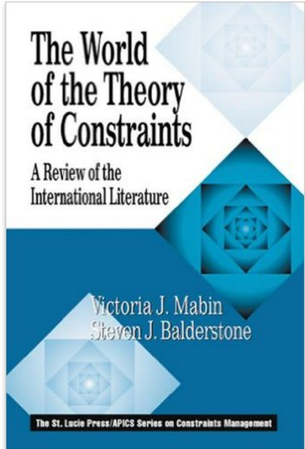
Aims and background
Aim – to bridge gap between academics and practitioners and to hold a mirror to see what outsiders see of TOC (what is available to academic researchers on TOC? What view are we presenting to the academic world?
Database to record:
TOC publications available in the published
‘academic’ literature
Follows on from The World of the Theory of Constraints bibliography

Slide 3
Acknowledgements
We gratefully acknowledge funding and support from our sponsors:
Victoria University of Wellington, University Research Fund 2015
The Goldratt Foundation
We also acknowledge and appreciate the input and guidance from our advisors:
Emeritus Professor James Cox, University of Georgia at Athens, and TOCICO Board Member
Steven Balderstone, Revive Business Improvement, Australia
Marcia Hutchinson, General Manager, TOCICO
Rami Goldratt, Goldratt Foundation
And thanks to all who supported us by keeping an touch and informing us of new publications

Slide 4
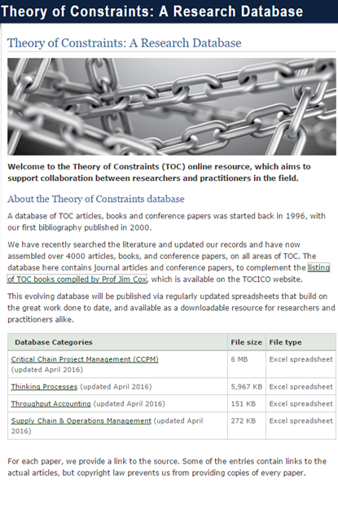
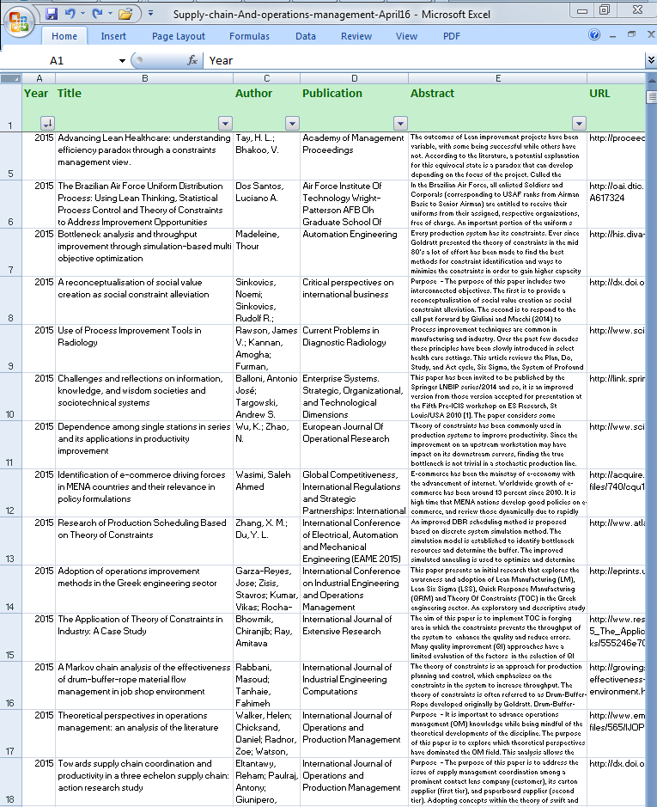
TOC Database Project
Notes:
4000 academic articles were found initially narrowed 2225
website and the other the look and feel of the data and the type of detail that is provided in the database
Excel
Not books, Books – link to books available in the website
Link on TOCICO website – click on TOC Books List
TOCICO papers/presentations– up till 2013 already included
Not TOCICO videos – clearly available to conference goers, to TOCICO members, less to outside

Slide 5
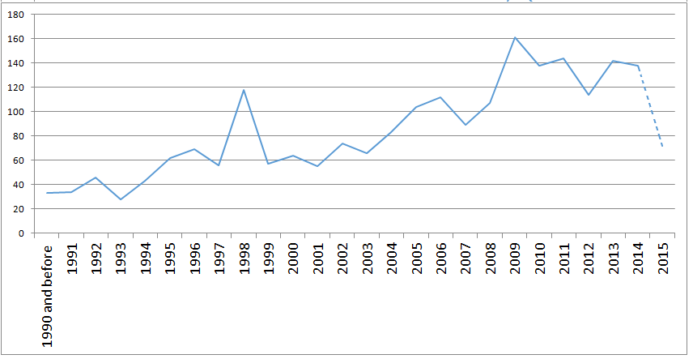
Overview of publications
Notes:
Comments:
Overview of ALL academic papers in the DB, including TOCICO papers
General increase
Why a dip in 2012?
Time delay picking up 2015 publications – also haven’t added TOCICO slides
Time to publish
Who is publishing?

Slide 6
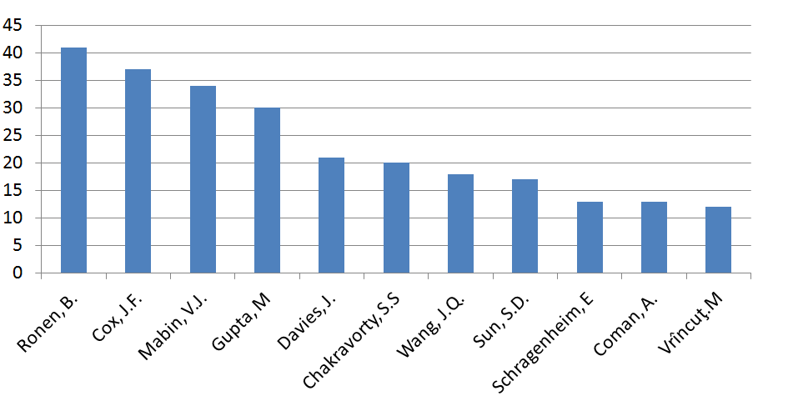
Who is publishing?
Major Authors in academic Database
Notes:
Over whole database

Slide 7
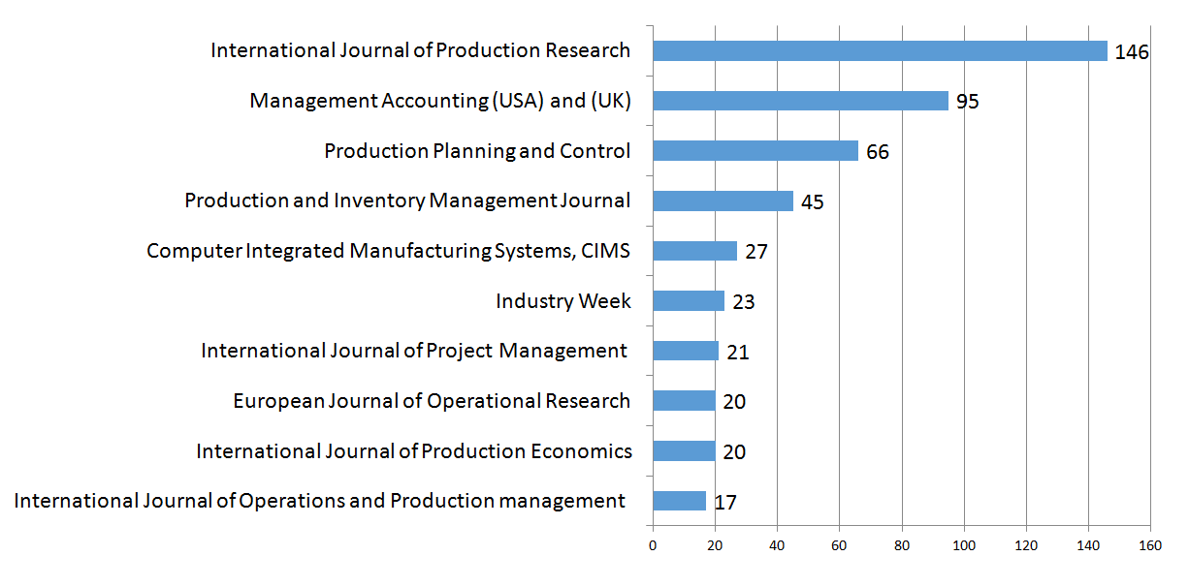
Top 10 journals by frequency
Where are TOC academic papers published?
Notes:
Journal of Human Systems Mgmt also had 11 papers in a special issue
Journal of Cost Mgmt had 10.

Slide 8
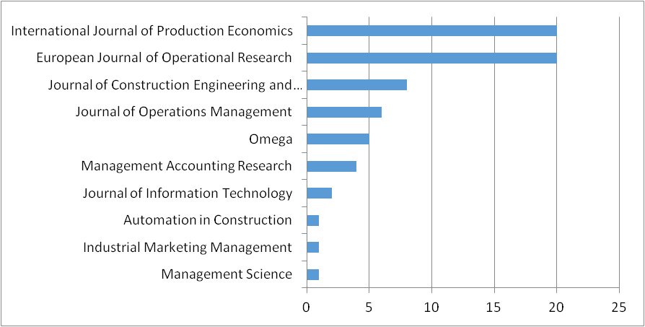
Top journals (A+)
Where are TOC academic papers published?

Slide 9
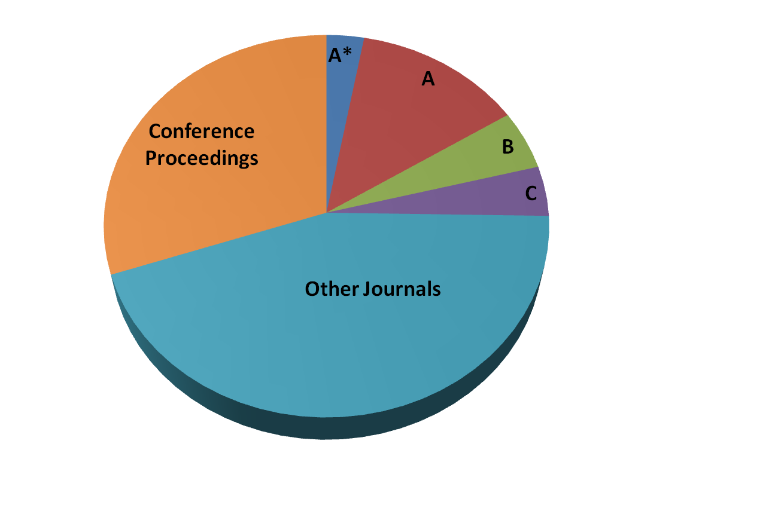
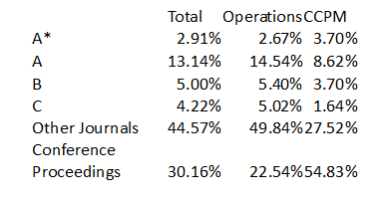
Overview of ranking
Where are TOC academic papers published?

Slide 10
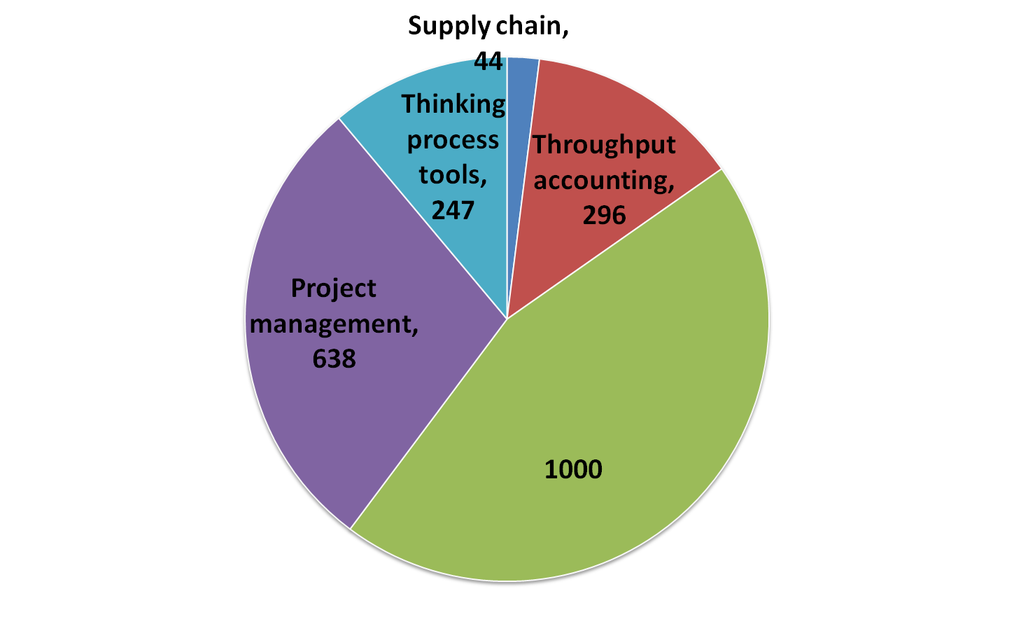
Classification of papers
Operations management
Notes:
Ops, SCM, Projects, TP, TA
Rest of paper focuses on Ops papers

Slide 11
Process of analysing the papers
Operations management
Total of 919 papers categorised as operations management including papers that applied TP to operations management
  110 papers were found to be only referring to TOC briefly and moving to other topics so were excluded from further analysis.
The analysis went through multiple iterations using NVivo, and were coded to maximum of five nodes
Initially the papers were divided into two major categories:
Methodological improvement
  Conceptual development
  Scheduling algorithms/mathematical development
Application
  Manufacturing
  Service industry
Notes:
This excludes Throughput accounting and TOCICO conference presentations
excludes SCM papers and those found to not really be about TOC – just included a mention in passing.
Nodes – like characteristics – 5 ways of grouping the data.
Within each categorisation, can have multiple categories – the data gets coded with descriptive words that can be picked up later to cluster papers according to multiple groupings.

Slide 12
Operations management
Methodological improvement
Conceptual development
A large number of conceptual papers were introductory (still)
Next largest group: papers comparing and contrasting TOC with other methods (we identified 40) e.g MRP, ERP, JIT, Agile, Lean, CONWIP, Six Sigma, and TQM.
There were also a few critiques
  Bottleneck concept
  DBR
  Reducing variability - a forgotten option
Notes:
A large number of conceptual papers were introductory (we identified 66) this is maybe due to wide variety of publication outlet
Critique on DBR
Kalir (2007) mentions DBR as a “traditional WIP management approach” and argues : “these local heuristic dispatching rules, have not explicitly addressed the underlying global WIP management goaling problem as a whole. Today, more and more fabs run multiple processes with a diverse range of volumes and mix of products. Since a majority of the resources (equipment and head-count) are shared amongst the various processes, the requirement to efficiently meet schedules and output goals becomes a complex, simultaneous, continuous process of resource allocation planning for each tool-set throughout all processes, operations, and products/lots.” Hendry and Kingsman (1989) argued that DBR does not provide support for customer enquiry, order acceptance and due date setting.
Full paragraph is here from Kalir, A. (2007). A novel breakthrough system for mixed production goaling and control in semiconductor manufacturing. International Journal of Production Research, 45(3), 555-569. doi: Doi 10.1080/00207540600792341 page 556
Still, these traditional WIP management approaches, commonly in use by many
semiconductor fabs, which are essentially local heuristic dispatching rules, have not
explicitly addressed the underlying global WIP management goaling problem as a
whole. Today, more and more fabs run multiple processes with a diverse range of
volumes and mix of products (Bang et al. 2005). Since a majority of the resources
(equipment and head-count) are shared amongst the various processes, the
requirement to efficiently meet schedules and output goals becomes a complex,
simultaneous, continuous process of resource allocation planning for each tool-set
throughout all processes, operations, and products/lots (Zorea et al. 2003).
As illustrated by Kalir et al. (2004), using a small-scale problem of a two-product
eight-operation line, applying traditional local dispatching heuristic rules that
attempt to maximize output and/or minimize tardiness consistently under-performed
by 20–30% on both output and on-time delivery, compared to the enumerative
identified optimal solution. It should come as no surprise, as the considerations
required are immense: product positions versus schedules, WIP levels at current
and downstream process steps, tool qualifications, current and expected tool
availabilities, batches, setups, cascading, technological time limits, process issues,
and many more.
Critiques on tradition Bottleneck concept
Several scholars argue traditional TOC methods is not feasible or advantageous when dealing with multiple constraint resource, and for complex production system where there are several bottlenecks(Bhattacharya, Vasant, Sarkar, & Mukherjee, 2008; Amitava Ray, Sarkar, & Sanyal, 2008; A. Ray, Sarkar, & Sanyal, 2010, 2011; Tanhaei & Nahavandi, 2013; Tanhaie & Nahavandi, 2011), often such arguments are introduction into developing a new algorithm or a method that enhances TOC existing methods. Therefore one can argue has been already an area of development within TOC.
Chakravorty and Atwater (2006) argue 100% bottleneck utilization jeopardise faster delivery. They found in their case study (door manufacturing) 80.3% as optimum bottleneck utilization, and argue based on fluctuations, other manufacturers need to calculate their optimum bottleneck usage.
Schrijvers et al. (2012) argue any process-oriented method including TOC, may cause several potential disadvantages: dehumanisation of work by centralised process, cost of data collection and process control, lack of time for employees to relieve stress, and dissatisfactions due to decreased radiation.
Reducing variability as a forgotten option
(Hurley & Clay Whybark, 1999) argue there are three approaches in dealing with uncertainty: buffering (using capacity as a way to be with uncertainty this includes but not limited to TOC methods), inventory (this is the traditional method used to put a work in progress inventory before every machine) and finally variance reduction techniques. They apply simulation which compares just in Time and TOC. The result indicates TOC method’s outperformed just in time. But the argument is that instead of investing on buffering or inventory we could also invest in variance reduction which they argue will make significant improvement whether we used TOC or just in Time. But the core argument is that we don’t even need to invest in buffering or inventory if we invest in variance reduction techniques. Protective capacity, and inventory would make more improvement to just in Time and only very little changes in TOC performance. According to the analysis inventory make in significant improvement in output rate, while protective capacity can make significant improvements in output rate, variance reduction make much more improvement in output rate.

Slide 13
Operations management
Methodological improvement
Mathematical development
Mathematical development for proposing, comparing, validating particular sequencing and/or scheduling techniques. These comprise:
  40% of all OM papers (319 papers)
  70% of TOC publications in A+ Journals (31 out of 44)
Simulation analysis (219 papers )
Nearly half (21 out of 44) of Publications that made it to A+ Journals used simulation to evaluate:
    DBR performance
    Heuristic decisions (batch sizing, buffer sizing, inventory trade-offs)
Mathematical algorithms (108 papers )
    28% of these papers used Fuzzy theory (30 papers)
Notes:
Fuzzy set theory was also used in CCPM very frequently (33)

Slide 14
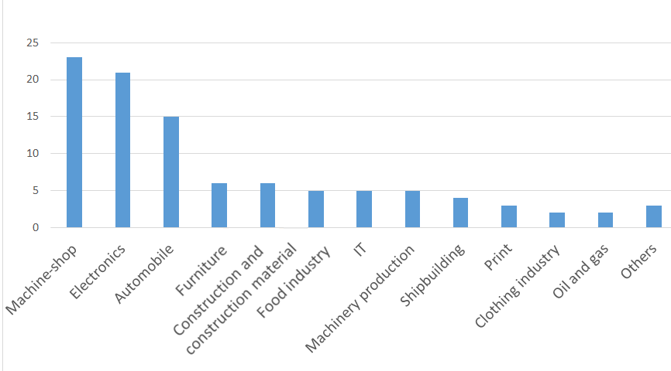
Application to Manufacturing
Context
Notes:
others : forestry and wood cutting, Product design, Aircraft

Slide 15
Application to Manufacturing
Processes used
Some organisations abandoned past practices replacing them with TOC and a holistic way.
Others applied some TOC techniques into their existing practices.
Majority of reports applied 5FS
We identified 16 reports of application of DBR
Few applications of thinking process tools
Only one report on application of SDBR
Hybrid models: e.g. TOC & MRP & JIT
Notes:
Hadas & Cyplik (2007), for example, used TOC in combination with MRP and Just in Time. They argue TOC is best to be used for scheduling production flow. They applied TOC analysis including VAT analysis, 5FS and buffer management to executive level decisions, other methods were used for planning level which include forecasting, production planning, capacity planning, and material requirement planning.
Note:
Drum buffer rope is the most frequently used TOC technique in operations management. Despite introduction of simplified drum buffer rope as a replacement to DBR, practitioners continue using and reporting application of DBR, similarly scholars seems to be more interested in DBR than SDBR with 175 related papers on DBR as opposed to only 9 reports on application or conceptual discussion on SDBR.

Slide 16
Application to Manufacturing
Results of TOC application
Difficulties in obtaining quantitative data from existing published records of TOC application
  Different manufacturers confront different types of problems
  TOC application varies in different contexts
  Different scholars report different types of improvements
  Insufficient information
Approaches used to evaluate TOC performance:
  By analysing how TOC adopters perform compared to other manufacturers. (e.g. Sale and Inman, 2003)
  By analysing correlation between adoption of various TOC method’s and organisation performance in a large pool of TOC and non TOC adaptors (e.g Inman, Sale, and Green, 2009)
  By analysing the impact of using TOC on performance of an organisation before and after TOC adoption (from published case studies) (e.g . Balderstone and Mabin,1998, World of TOC, 2000, IJOPM 2003)
Notes:
We can also include some discussion around practical issues related to such studies
By analysing how TOC adopters perform compared to other manufacturers.
e.g. Sale and Inman (2003) found that TOC adopters perform significantly better than both JIT and adopters of traditional manufacturing methods.
e.g Inman, Sale, and Green (2009) found 10% adoption of TOC among manufacturers in USA., They identify that a significant correlation between adoption of various TOC method’s and organisation performance among those adopters of TOC (110 of whom participated in their survey).
By analysing the impact of using the TOC on performers of an organisation before and after TOC adoption (published before and after studies)
e.g . Balderstone and Mabin (1998) for example provided a quantitative report on Lead-Times, Cycle-Times, Due-Date-Performance, Inventory Levels, and Revenue using 80 cases.
Different manufacturers confront different types of problems prior to adopting TOC.
TOC application varied in different contexts. For example, some applied TOC at the top level while others used only some TOC mechanisms to make a particular intended improvement. They also differ in terms of which TOC practice they used and how they were combined with other existing methods (such as MRP, JIT, TQM). Thirdly, while all empirical result report improvement, the perceived definition of improvement slightly differ. Accordingly, different scholars report different types of improvements. And finally, not all TOC adopters provided quantitative data on the impact of using TOC. Nevertheless, a subset of the above application provided quantitative data which is used here and in combination with Balderstone and Mabin’s (1998) meta-analysis which will be presented in due course.

Slide 17
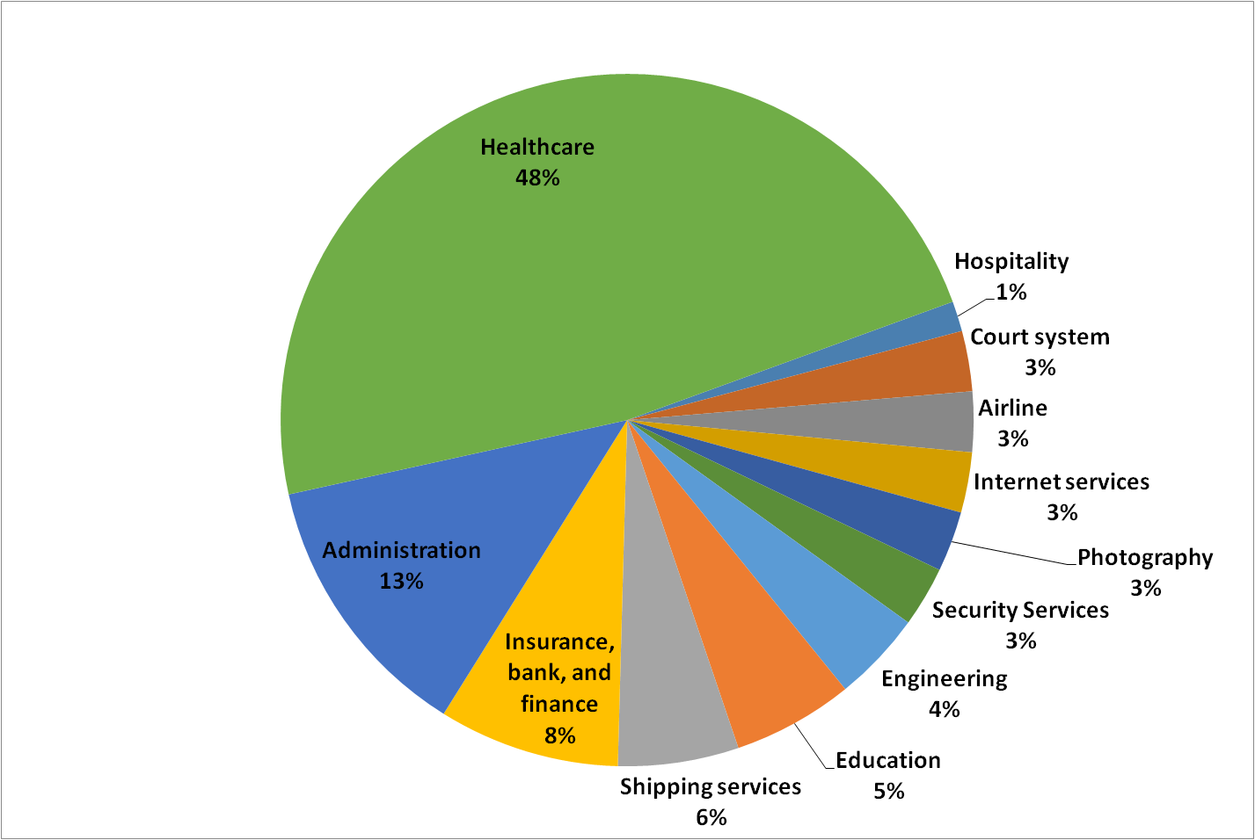
Application to Services
Context – case studies and suggested application areas
Notes:
healthcare is by far the largest TOC application area with several case reports and many other exploratory papers examining or suggesting application of TOC to healthcare.
Floyd and Ronen (1989) were first to publish the idea of applying TOC to healthcare administration by discussing the application of TOC to a hypothetical dental office. The earliest case study that reports application of TOC in service industry is an Israeli insurance company (Eden & Ronen, 1993), the case uses other manufacturing methods including JIT and TQM alongside TOC. Interestingly, the problem statement in the case also resembles the language often used in manufacturing such as long lead time, and high level of work in progress. Some early applications of TOC to Administration were in fact Administration of manufacturing companies (M. S. Spencer & Wathen, 1994). Since then several other application of TOC to other Administration contexts have been recorded (Gillespie, Patterson, & Harmel, 1999; Ke-hang, 2009; Mishra & Palo, 2014). More recent examples seem to demonstrate more holistic and comprehensive approach to administration, than mere process. For example, using interviews and qualitative analyses alongside the five focusing steps Mishra and Palo (2014) capture a rich picture of various types of constraint. They examined the effects of organisation structure and processes, relationships between people, and attitudes and culture, to the performance in administration system.
Another area of application of TOC to service is related to distribution and management of warehouses. Similar to Administration, distribution of a manufactured product was among the early adopters (Overall & Papp, 1995). However, non-manufacturing distributions were also reported as early as 1994 (M. Spencer).

Slide 18
Application to Services
Process
Practices within service industry healthcare:
    Major focus has been on flow, care pathways, and healthcare logistics:
    Application of DBR
    Hybrid methods (TOC, Six Sigma, business process redesign, Lean, and simulation)
    A few applied Thinking Process tools
    5FS and TOC measurements system
Practices within Administration
    Five focusing steps
    Application of DBR and VATI analysis
    Hybrid methods (TOC, Six Sigma, business process redesign, Lean, and simulation)
Notes:
Care pathway concept is a multidisciplinary area with attention to sequencing and coordinating activities of care process, monitoring and evaluating variability in clinical practice and outcomes in order to improve quality and resource utilisation.
Examples of other practices in Services:
DBR for managing a university library
Delphi analyses to explore constraints in teaching and learning
TOC focusing concepts applied to customer service management in hospitality industry

Slide 19
Application to Services
Result
Service industry presents a smaller but growing application area compared to manufacturing
The results of application are also not as good as in manufacturing
Some of the reasons:
  Visibility as barrier to adopting TOC in service industry
  Perceived disadvantages of focus on flow in healthcare:
    dehumanises the process
    reducing the patient’s choices and personal relationship between the health professional
    potential mistrust caused by control mechanisms
Notes:
Knaggs (2013) argues that visibility is the most important barrier to adopting TOC in Administration process. Nevertheless, his research indicates that even very complex administrative process can benefit from TOC provided that the mechanism is centred on processes and process time reductions.
Disadvantages of Focus on flow and care pathway: dehumanises the process, reducing the patient’s choices and personal relationship between the health professional, cost and potential mistrust caused by control mechanisms. Imposed time limitation also may hinder quality and communication. Response to this by Mur-Veeman and Grovers (2006) who argue the challenges in healthcare are existing reality of managing patient logistics. Only by focusing on this, can we provide some better solution to them by dealing with issues in a coherent and more effective way.

Slide 20
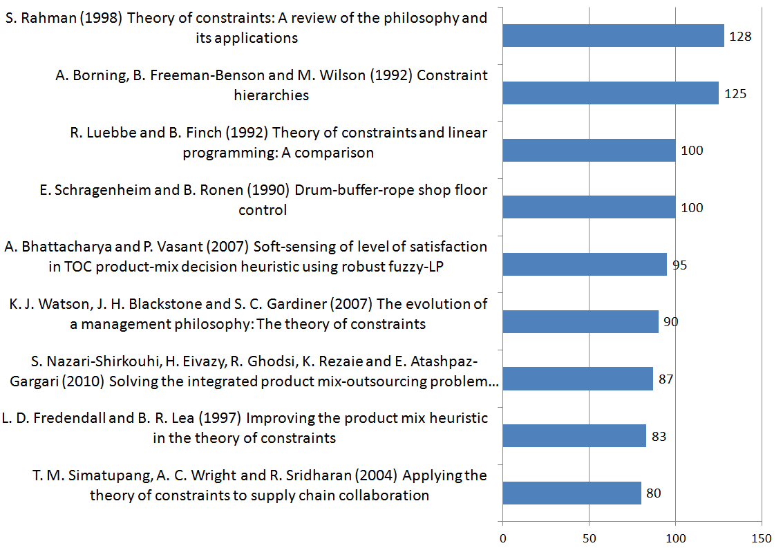
Most cited papers* – Scopus
* Based on search using “theory of constraints”

Slide 21
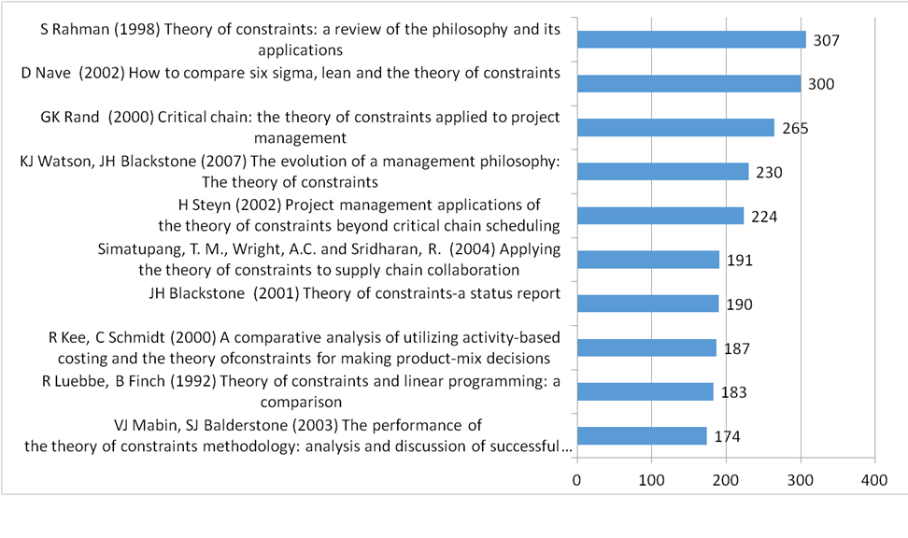
Most cited papers* – Google scholar
*Based on search using ‘theory of constraints’

Slide 22
Findings
Mathematical developments make it into A+ journals
Only 7% of A+ papers and none of most cited papers describe actual applications
Most cited papers are
    Introductory papers
    Literature reviews
    Comparative analysis

Slide 23
Implications
Where to from here?
How can we make more up to date information on TOC available to outsiders eg
  White papers on new methods/knowledge
  Academic papers
  Applications papers
  More papers on current trends

Slide 24
Please email us at toc@vuw.ac.nz if you:
know of other papers to add
have a particular paper you need help to access
want to add or make any changes to an entry
want to discuss the possibility of collaborative research or give some feedback
would like to be kept informed of any major updates or additions to the database

