Slide 1

Te Whānau o Ako Pai Wellington Faculty of Education

Slide 2
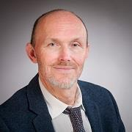
Professor Stephen Dobson, Dean of Education Kia ora, welcome, Selamat datang,欢迎, Talofa lava, Kia orana, Mālō e lelei, Ni sa bula vinaka, Faka'alofa lahi atu, Fakatalofa atu, Kam na mauri, Gud de tru, Kaselehlie, Halo olgeta, Ia orana, Aloha mai eاهلا و سهلا,. Ranked 73rd equal in the world for Education by Subject 2021 Times Higher Education), the Wellington Faculty of Education has a long tradition of high-quality teaching, learning, research, and engagement with society. We have 1000 students and 70 staff.

Slide 3
Vision
We are committed to Te Tiriti o Waitangi (the Treaty of Waitangi).
We educate for social and ecological justice.
We undertake transformational research, with a focus on teacher education, educational psychology, and education studies.
We teach and prepare students for lifelong learning.
We engage in cultural partnerships that enhance and strengthen our relationships with communities locally, nationally, and internationally.

Slide 4
Our programmes
Initial Teacher Education (Early Childhood Education, Primary, Secondary)
Education studies
Educational Psychology
Master of Education
Master of Secondary School Leadership
Doctorates (PhD or EdD)

Slide 5
Highlights on Research
Looking to our past to understand the present
Looking to our past to understand the present | Wellington Faculty of Education | Victoria University of Wellington (wgtn.ac.nz)
ECE teachers essential workers in all but name
ECE Teachers Essential Workers in all but Name | Newsroom
Schools are failing to identify high-ability science students, research shows
Schools are failing to identify high-ability science students, research shows | News | Victoria University of Wellington (wgtn.ac.nz)
Telling stories might help teens reeling from the effect of COVID coverage
Fears loom for teens undergoing vital brain development during COVID. Telling stories might help (theconversation.com)

Slide 6
Te Kura Māori
Te Kura Māori is an academic unit comprising Māori and Pacific scholars, teachers, researchers and students dedicated to increasing awareness and understanding about indigenous education in Aotearoa and the Pacific.
• As guardians of mātauranga Māori [Māori knowledge] for the faculty, Māori academics engage in research, teaching and professional learning that promotes and advances mātauranga Māori.
• As the voice of Pacific education in the faculty, Pasifika academics work closely with Pacific communities in Aotearoa and across the region, conducting research and offering evidence-based guidance about Pacific education initiatives.

Slide 7
Our Institutes/Clinics
Institute for Early Childhood Studies (1995)
The Institute promotes excellence in early childhood education through:
research
policy studies
information services
The Institute maintains strong links to early childhood teacher education and early childhood professional development through the involvement of its members in these areas.

Slide 8
Our Institutes/Clinics
Autism Clinic (2019)
The staff of the clinic work:
with children under the age of five who have, or are suspected of having, autism, their families and whānau, caregivers and teachers. The staff also work with therapists and other health professionals.
extensively with the Early Start Denver Model (ESDM), a play-based behavioural therapy. Through fun, naturalistic interactions with parents, caregivers, and therapists, the ESDM can accelerate learning and skill development for young children with, or suspected to have, autism.

Slide 9
Our Institutes/Clinics
Planned re-establishment of the EdPsych Clinic (2022)
The educational psychology clinic will provide:
an essential service to an under resourced community,
equity in mental health needs, and
advancement and opportunity of the Educational Psychology programme
The clinic also has the long-term potential to become a research clinic which supports student and staff development and advances knowledge in this area specific to Aotearoa.

Slide 10
Our Institutes/Clinics
The Virtual Learning Lab (to be established 2022)
This lab will conduct higher education research across the University and:
organise research events;
build a strong research culture on University pedagogy;
pursue national and international funding opportunities;
establish high quality, strategic research relationships with external national and international partners.

Slide 11
Further Planned Virtual Centre
Centre of Excellence with Capital Normal University, China (currently under discussion)

Slide 12
Strategic Projects
Targeted outreach in the community space and professional/school/ECE centre sectors
Building research leadership capacity
Development of:
a Māori Research Centre
a Pasifika Research Centre
an international strategy
a special project on tolerance and peace

Slide 13
Relationships
Onshore:
Te Kura (state- funded distance education provider, 23000 students)
Education Review Office
Ministry of Education
New Zealand Council for Educational Research
New Zealand Qualifications Authority
Teaching Council of New Zealand
Post Primary Teachers Association (represents secondary teachers)
New Zealand Educational Institute (employee association represents ECE and primary teachers)
Offshore:
University of Ottawa
The Education University of Hong Kong
University of South Australia
UIN Syarif Hidayatullah Jakarta
Universitas Negeri Jakarta

Slide 14
Centre of Excellence – Educating for the Future
A MoU was signed in 2020 bringing to life a virtual Centre of Excellence – Educating for the Future. Partnering with Te Herenga Waka-Victoria University of Wellington in this Centre are:
UIN Syarif Hidayatullah Jakarta
Universitas Negeri Jakarta
University of South Australia

Slide 15
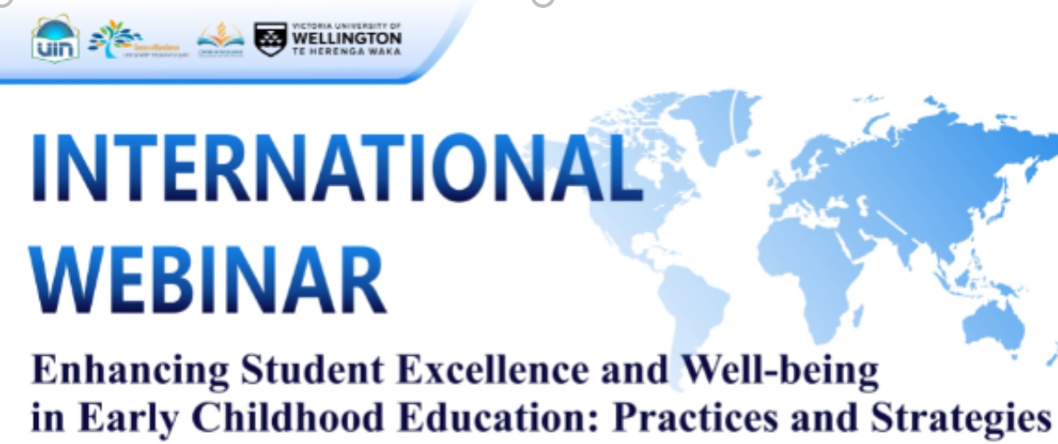
Centre for Excellence – Educating for the Future – Activities
Featuring educational psychology staff members Dr Amarie Carnett and Dr Kelly Carrasco presenting on Interventions in the classroom environment to promote prosocial behaviours

Slide 16

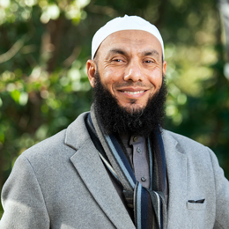
Centre for Excellence – Educating for the Future – Activities
Featuring one of the key representatives for the Parties to the MoU for the Centre, Dr Professor Mohamad Abdalla, Director, The Centre for Islamic Thought and Education, University of South Australia

Slide 17
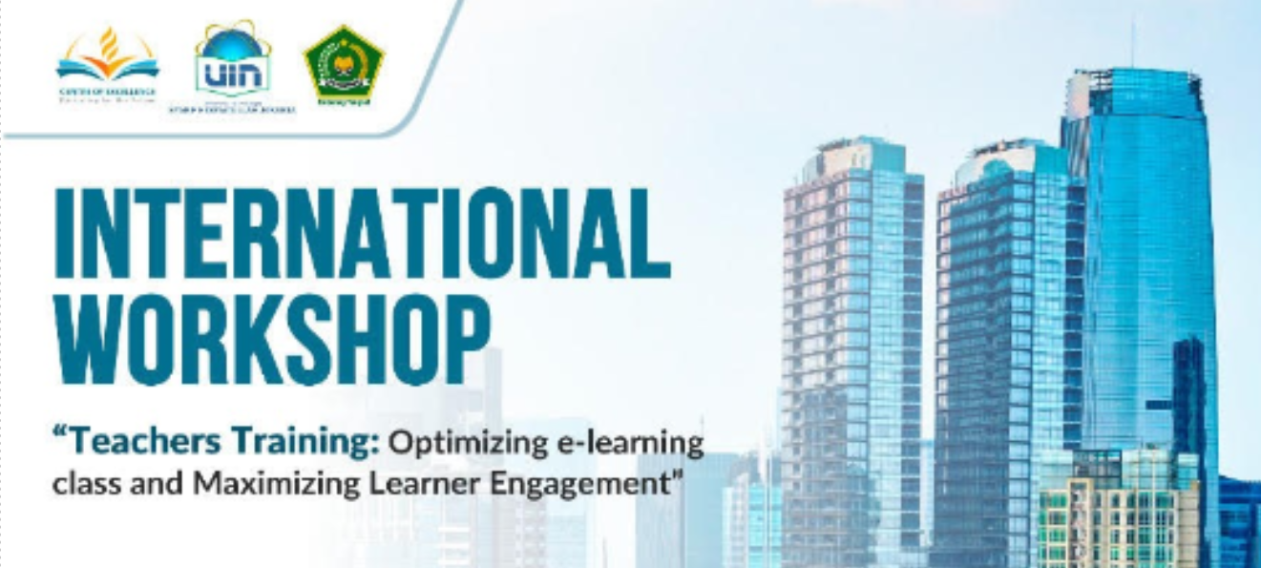
Centre for Excellence – Educating for the Future – Activities
Featuring two of the key representatives for the Parties to the MoU for the Centre, Dr Sururin, Dean of the Faculty of Education, UIN and Professor Stephen Dobson, Dean of the Wellington Faculty of Education, VUW

Slide 18
Intra-University relationships
School of Linguistics and Applied Language Studies
The School of Linguistics and Applied Language Studies (LALS) is well known for its graduate programmes for teachers of English to speakers of other languages (TESOL) and its undergraduate programmes in TESOL, linguistics and language study.
LALS staff lead and participate in research into language, language use, language learning, language teaching and assessment.
The school is actively involved in ESOL teacher education and staff professional development in Southeast Asia, East Asia, as well as in New Zealand.

Slide 19
Intra-University relationships
English Language Institute (ELI)
The ELI offers a pre-degree programme in English for Academic Purposes, a Graduate Certificate in TESOL for pre-service teachers, and a range of courses tailored to the needs of specific groups.
ELI staff have extensive experience in delivering training courses to a diverse range of public and private sector participants.
Courses delivered in Wellington, New Zealand
Since 1961, English for Academic Purposes courses to prepare students to enter undergraduate and postgraduate study; and pre-service teacher education courses towards the Graduate Certificate in TESOL.
Since 1991, English language courses for ASEAN and Mongolian government officials focused on a particular theme
Since the early 2000s, in-service teacher education programmes for primary, middle and high school teachers and university lecturers from China, Indonesia, Pacific Island nations, Thailand, Saudi Arabia and Vietnam.
Since 2004, workplace communication courses for underemployed and unemployed skilled migrants

Slide 20
Intra-University relationships
English Language Institute (ELI)
Courses delivered offshore or remotely:
From 2006 - 2016, English for Academic Purposes courses to students at our Ho Chi Minh, Vietnam, campus.
From 2006 - 2010, English for Academic Purposes materials for the Omani Ministry of Higher Education for five new Colleges of Applied Science.
Since 2013, four-week English for ASEAN or English for APEC courses in the ASEAN region.
Since 2012, bespoke English language courses for government officials in the Pacific and ASEAN region.

Slide 21
Some of our Adjuncts
The Faculty has local and international adjuncts:
Adjunct Professor Lester-Irabinna Rigney, University of South Australia, has worked in Aboriginal Education for over 20 years across the Pacific, in New Zealand, Taiwan and Canada.
Adjunct Fellow Tahir Nawaz is a well-known and highly respected member of Islamic communities across New Zealand and advised the Government following the mass shootings in two mosques in Christchurch in 2019.

Slide 22
Tūngia te ahi o te mātauranga
Kia tipu ai
Kia manahana ai te katoa
Kua mutu te tangi o tēnei manu
He mihi tēnei kia koutou
I haramai ki te whakanui tāku kōrero
Tēnā koutou, tēnā koutou, tēnā koutou katoa
As-salam alaykom (peace be upon you)
Kindle the fires of learning
Nurture them so they will grow
To give warmth and light to all
the bird has stopped speaking
your presence has enhanced my talk)
thank you, thank you, thank you all
As-salam alaykom (peace be upon you)

