Slide 1
Māori at mahi: Easy ways to use Te Reo Māori when at work
Dr Ben Walker
Te Kura Whakahaere - School of Management
Te Herenga Waka - Victoria University of Wellington

Slide 2



Ngā hui
(Meetings)
Ngā kupu whakatimata īmera (Email openings)
Ngā wā whakatā
(Break times)

Slide 3

NGĀ HUI
MEETINGS

Slide 4
Sorry for my lateness!
Arohamai mō taku tūreititanga!

Slide 5
I have a question
He pātai tāku

Slide 6
Do you have a question?
He pātai tāu?

Slide 7

NGĀ KUPU WHAKATIMATA ĪMERA
E-MAIL OPENINGS

Slide 8
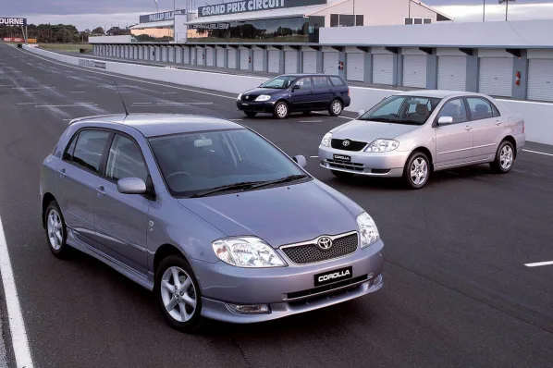
Kia ora =
Hello

Slide 9
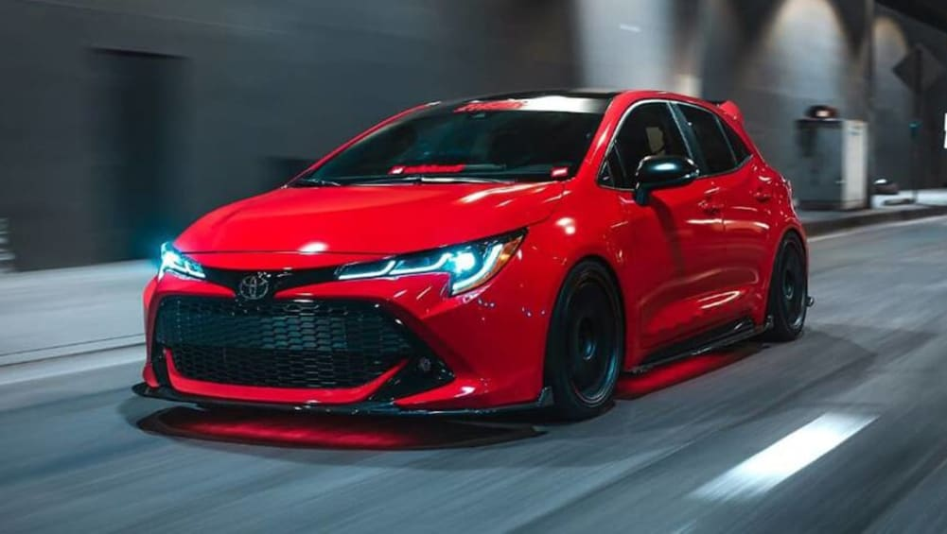
Tēnā koe =
Greetings to you

Slide 10


Slide 11
…koutou
…kōrua
…e hoa
…e te tīma
…hoamahi mā
everyone/ya’ll
you two
friend/mate
team
colleagues

Slide 12

NGĀ WĀ WHAKATĀ
BREAK TIMES

Slide 13
Are you teaching these days?
Kei te whakaako koe i ēnei rā?

Slide 14
Oh no!! ☹
Aue!! ☹

Slide 15
That’s awesome!
Ka rawe!
Tau kē!
Mīharo!
Ka mau te wehi!

Slide 16

KUA MUTU! ☺
FINISHED

