Slide 1

WHAKAMANAWA:
Honouring the voices and stories of Māori who submitted to the 2018 Government Inquiry into Mental Health and Addiction in Aotearoa
Dr Lynne Russell (Kāi Tahu, Ngāti Kahungunu, Kāti Māmoe, Ngāti Porou)
Dr Michelle Levy (Waikato, Ngāti Mahuta)
Lisa Cherrington (Ngā Puhi, Ngāti Hine)

Slide 2
For those of us who are patients, hope is not a small thing. It is life and death. It is the difference between surviving and drowning. Between falling and rising. Hope is to our spirit as oxygen is to our bodies ... We need to be surrounded by those who see our strengths and what we can offer the world …
Māori with lived experience

Slide 3
WHAKAPAPA
What is Whakamanawa?
How did Whakamanawa come about?
What were our roles in its development, and in the Inquiry?
Where is it now?
“Honouring the collective voice of Māori with lived experience, whanaunga of those with lived experience, whānau bereaved by suicide, and kaimahi Māori working in the mental health, addiction and suicide prevention sectors.” p.10

Slide 4
Ten thousand nine hundred and fifty ways to say enough, and yet we always find more …
Then. We speak.

Slide 5
HONOURING MĀORI VOICE
Meetings notes from 119 consultation hui
96 written submissions
74 online submissions
3 phone calls made to the Inquiry 0800 number
“Every one of these submissions from Māori was collated, read, carefully considered and robustly analysed by the researchers ...” p.11

Slide 6
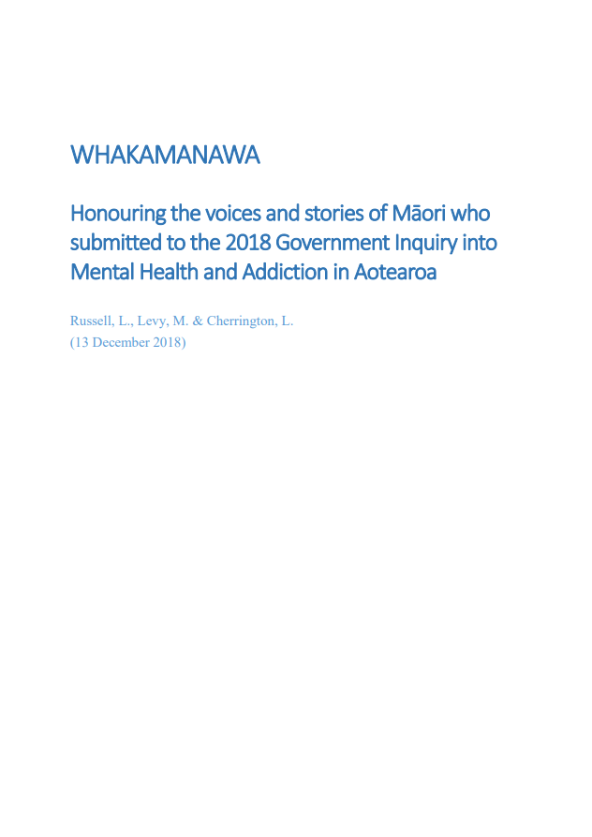
WHAKAMANAWA OVERVIEW
207 pages documenting all Māori written, oral, online and phone submissions to the Inquiry - intentionally comprehensive
Purpose: to provide a record of that voice, so that YOU can take it forward
“Our people – the Tāngata Whenua of Aotearoa – have spoken ... our words – our collaborative voice – are strong, painful, honest and unequivocally clear.” p.3

Slide 7

PART ONE: Looking to the Future
Te Mana o te Tiriti o Waitangi
National and International Navigation
Paradigm Shifts
Whānau Ora: Our Wellbeing Paradigm in Action
Transformation: Wellbeing System Responses
Kaupapa Māori Service Provision
Workforce
Suicide, Suicidality and Self-Harm
Alcohol, Other Drugs and Addiction
Responding to Trauma
Research
PART TWO: Challenges Faced
Colonisation
Multiple Marginalisations
Our Service Realities: Access
Our Service Experiences
Kaupapa Māori Service Realities

Slide 8
The responses and solutions reside in the realisation of treaty guarantees and whānau, hapū, iwi rangatiratanga/self-determination – [in] the development of alternative responses and ways to approach mental health and wellbeing.
TE MANA O TE TIRITI O WAITANGI
Whanaunga of someone with lived experience

Slide 9
To do nothing, to continue on the same trajectory, is to fail. Iwi leaders have a stake in the ground – pou a kia tina – that this state of unwellness is not a legacy that we can pass on to future generations.
TE MANA O TE TIRITI O WAITANGI
Māori organisation/service provider/group

Slide 10
[We are] committed to developing a true treaty of waitangi relationship [and that] is not about meeting contractual outcomes but wider than that. We want surety that [named iwi] will be given equal rights to support [named iwi] whānau; and this is appropriate for all iwi.
TE MANA O TE TIRITI O WAITANGI
Iwi leader at Te Rau Matatini consultation hui

Slide 11
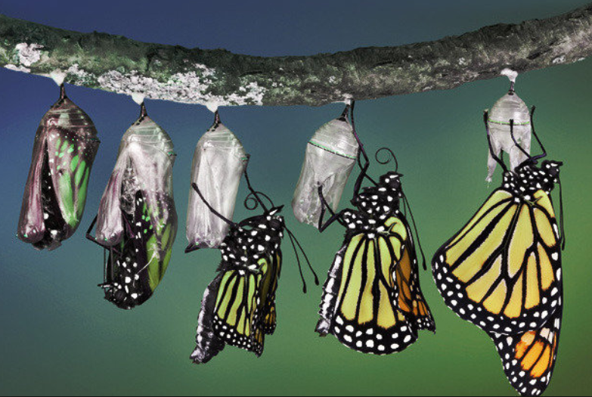
5. Transformation: Wellbeing System Responses
5.1. Radical System Redesign
5.2. Wellbeing Commission
5.3. Determinants of Wellbeing
5.4. Cultural Connectedness
5.5. Building Resilient Communities
5.6. Challenging Racism
5.7. Challenging Stigma
5.8. Optimal Service Responses
5.9. Whānau Wellbeing
5.10. Funding for Wellbeing: System Transformation

Slide 12
There needs to be secure healthy housing for everyone so that communities can grow, develop and thrive. There needs to be flexible, meaningful work for everyone. Every citizen needs to have many opportunities to reflect and build on their identity, culture and relationships. Schools can play a part in this as hubs of the community with community-based adult education and continuing learning opportunities. [There needs to be] more focus on sustainable living and social justice rather than the hyper-focus on economic growth.
Whanaunga of someone with lived experience

Slide 13
We can whakamana our whānau by restoring and returning to our indigeneity as imbued through kawa oranga. [We have] integral rites across the lifecourse continuum, and te reo me ō̄na tikanga, that instill deep connections to the natural and spiritual worlds.
Māori organisation/service provider/group

Slide 14
Unless we shift our thinking, we won’t shift our practice.
Māori service provider

Slide 15
In the midst of crisis, pain, trauma and trouble your eyes turn to possibility. You see past the diagnosis, the addiction, maybe the gang patch, their last criminal offence and the chaotic situation. You see the person and their whānau. You hold hope and see the sunshine for those who may not have the energy or will at that moment to see it for themselves.
Whānau Ora: Our Wellbeing Paradigm in Action
Kaimahi Māori who is also whanaunga of someone with lived experience

Slide 16
The integration point across all of the services is the practice of a Whānau Ora model. The strength[s] of … [our] organisation … [are] the multiple range of services it offers, [having] a strong relationship and networks with its community, as well as being governed by three of the iwi of the area. This means that the referral point might be an individual but … [the] approach is to work with that individual and their whānau, utilising its many connection points (internally and externally).
Whānau Ora: Our Wellbeing Paradigm in Action
Māori organisation/service provider/group

Slide 17
They’ve given me the right to be me.
Kaupapa Māori Service Provision
Māori representative of a collective

Slide 18
Addressing the cultural, environmental, socio-economic and historical factors that have impacted the mental wellbeing of Māori, through cultural paradigms such as whakawhanaungatanga, has been the domain of Kaupapa Māori mental health services for decades.
Kaupapa Māori Service Provision
Māori organisation/service provider/group

Slide 19
[We are] one of the few remaining iwi providers of mental health and addiction services … the environment is becoming increasingly difficult to maintain a culturally lead, clinically sound and financially sustainable service … [it] has seen a growing number of national providers establish their services … as they leverage their economies of scale but this has not always lead to improved services for our tāngata. Iwi providers are slowly being squeezed out from supporting their own whānau, which is unacceptable.
Kaupapa Māori Service Provision
Māori organisation/ service provider/group

Slide 20
We would have a Rehab centre for AOD that was Kaupapa Māori-based and tikanga-based. We would have Kaupapa Māori and tikanga-based residential respite located in the bush. Because going away to Rehab is a barrier for some of our whānau. So in an ideal world they would not have to go away to [named city]or to the Salvation Army service.
Kaupapa Māori Service Provision: ADDICTION
Participant at Kaupapa Māori service provider consultation hui
Notes:
LYNNE

Slide 21
WE ARE DONE
’The system’ has failed our whānau – NO MORE
Shut up, sit down, and listen
“We all wish everyone would shut up and listen to us, the ones who live it everyday.”
We know our communities best – including how to heal them

Slide 22
Reducing suicide should not be a focus of specific services, but should be an outcome of wellbeing strategies in all services. Schools, all healthcare services including service for older people, community and inpatient services, rural and urban services, prisons [and] local authorities need to work together towards the same thing. The message should be about everyone’s life having worth.
SUICIDE
(Māori organisation/service provider/group

Slide 23
Conclusion
How will YOU honour these voices?

